Slide 1
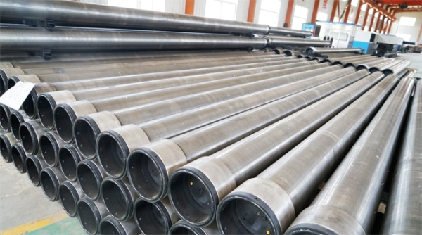
Partner (Tianjin) Oilfield Technology Services Co., Ltd.
Premium Connection OCTG Supplier

Slide 2
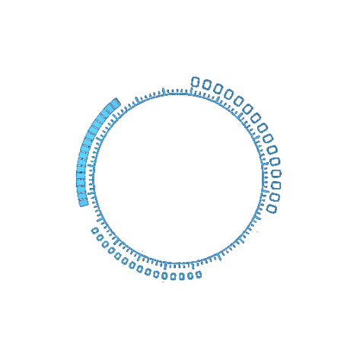
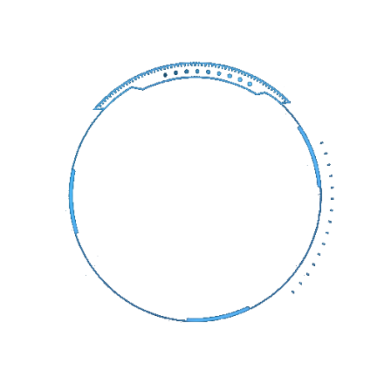
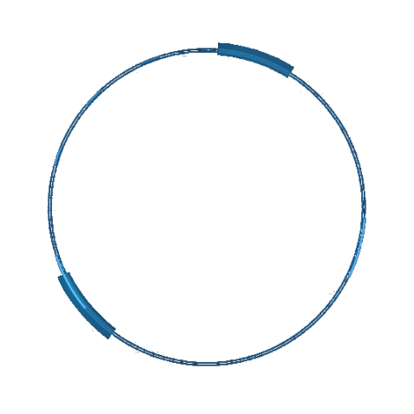
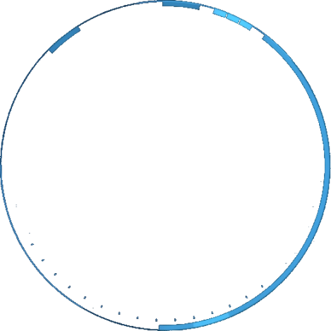
Catalogue
Brief
Facilities
Production Process
Products
Inspection
Others
©Partner (Tianjin) Oilfield Technology Services Co.,Ltd.

Slide 3
Brief
Partner (Tianjin) Oilfield Technology Services Co., Ltd. is a qualified supplier of CNOOC & COSL. Our main product is API OCTG, Premium connection product & sand control screen pipes.
At the same time we can provide oil tools & equipment rental and maintenance services.
To provide one-stop solution for users, we established partnership with many large enterprises in China.
We have set up products processing base in both Tianjin and Cangzhou City. We enforced our relationship with TPCO & VALIN Hengyang steel and other large state-owned enterprises to
serve our client better. Especially in boiler pipe & pipe fittings.
©Partner (Tianjin) Oilfield Technology Services Co.,Ltd.

Slide 4
Brief
Product Range
1. Casing running tools & equipments. supply, rental & maintenance. 2. OCTG(tubing, Casing, DP, Pup joints, X-over), Premium connection (Flush joint, Metal to metal connections ) & API connections. Processing , repair & maintenance. 3. Oil pipe, conductor, insulated tubing, flange & other pipe fittings. Machining, such as perforated hole, laser slotted, cutting, coppering, phosphating, layer for both inside & outside 4. OCTG accessories, including couplings, thread protectors, Klepo type/ mechanical type protectors, stabbing guide, as well as other rubber/plastics products. 5. Float shoe & collar, liner hangers. 6. Rental of drill efficiency tools.
©Partner (Tianjin) Oilfield Technology Services Co.,Ltd.

Slide 5
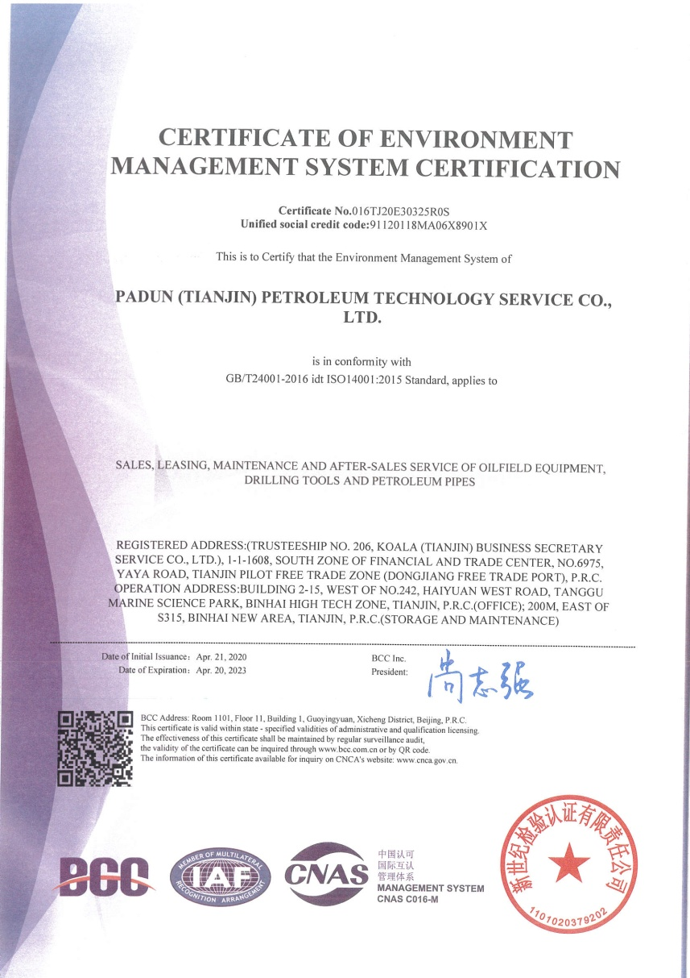
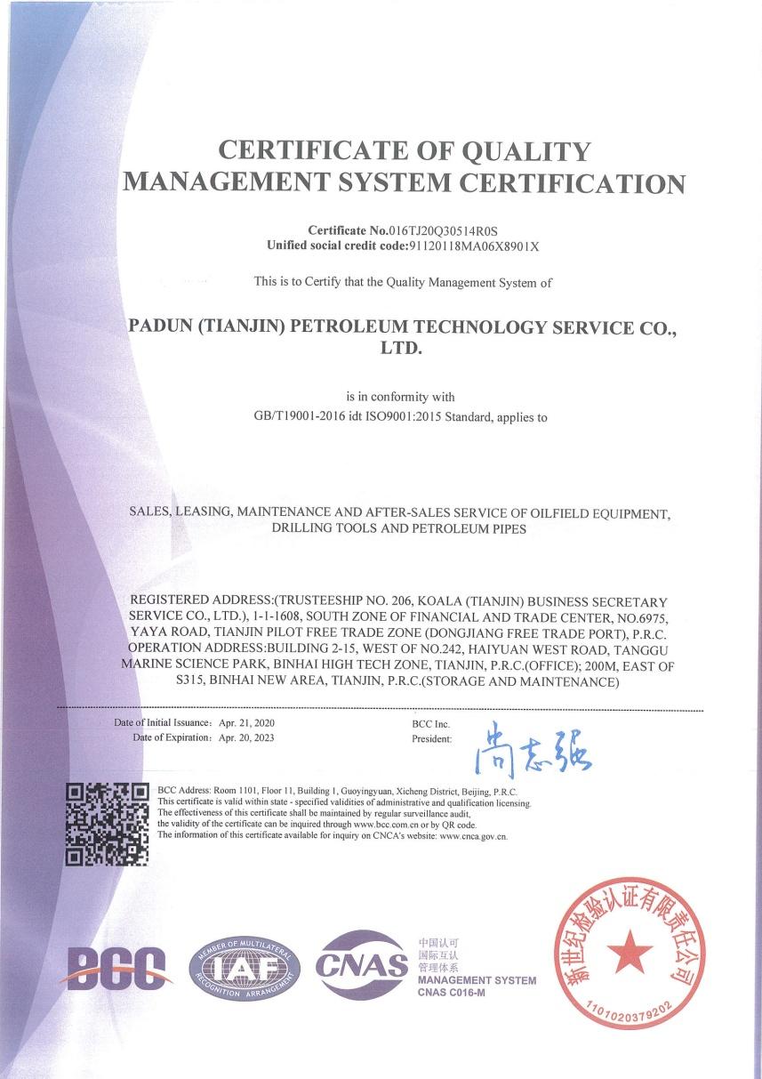
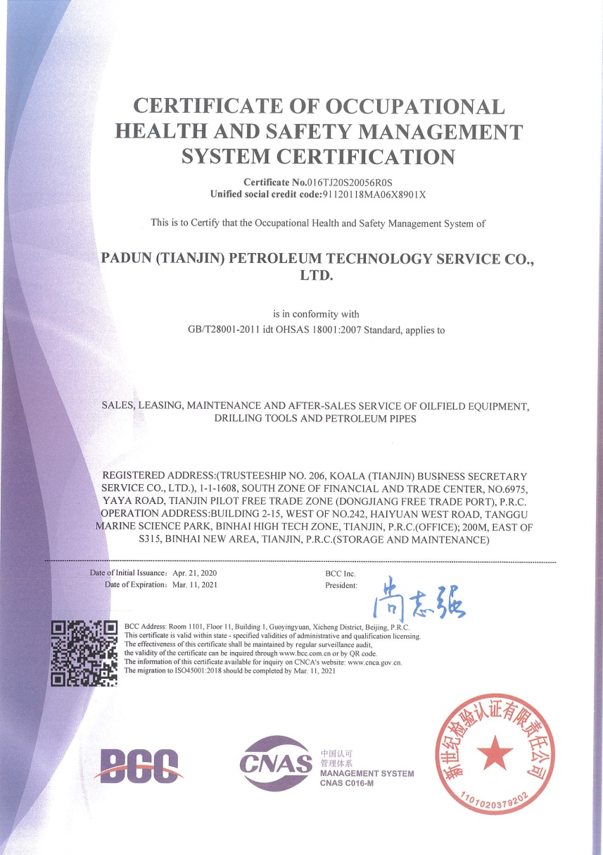
Certificates
©Partner (Tianjin) Oilfield Technology Services Co.,Ltd.

Slide 6
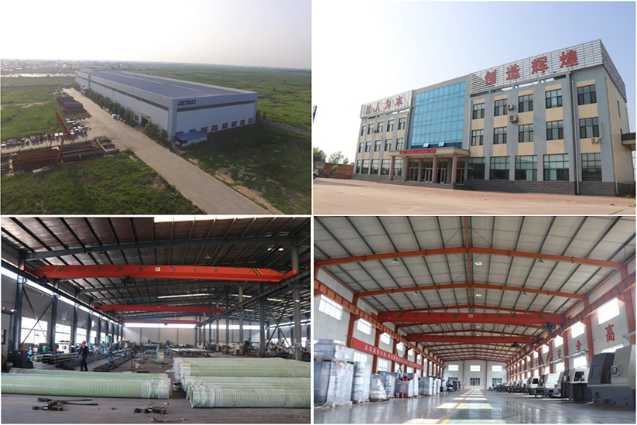
Facilites
©Partner (Tianjin) Oilfield Technology Services Co.,Ltd.

Slide 7
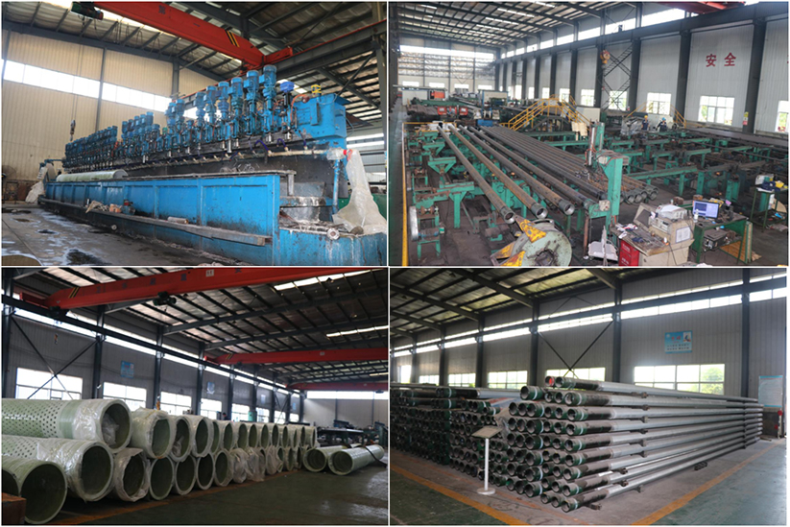
Facilities
©Partner (Tianjin) Oilfield Technology Services Co.,Ltd.

Slide 8
Processing
Iron making
Cold drawn
Steel making
Size & visual check
Continuous casting
NDT
MPM rolling
Pipe making
Hydraulic& drift test
PQF rolling
Inspection
Assel rolling
Threading
End beveling
Perforated
slotted
coating
layers
Marking
Packing
©Partner (Tianjin) Oilfield Technology Services Co.,Ltd.

Slide 9
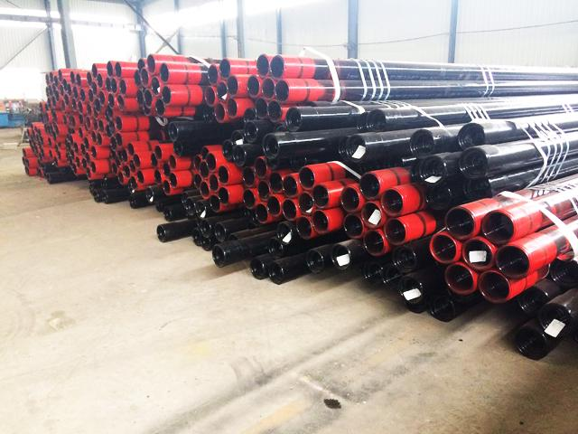
Product：API OCTG
API 5CT/5DP standards
Casing：4-1/2"-20"
Connection：BC, LC, SC
Tubing：1.05"-4 1/2"
Connection：NU、EU、
Grade：J55, K55, N80, L80, T95, P110, Q125
©Partner (Tianjin) Oilfield Technology Services Co.,Ltd.

Slide 10
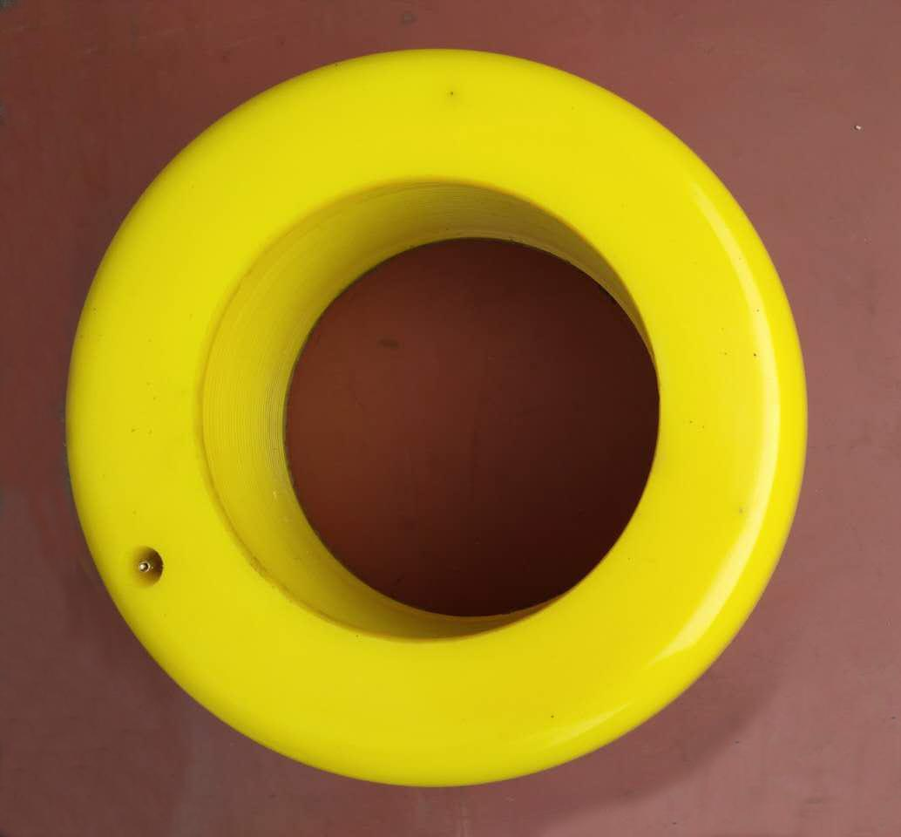
Product： Air-Operated Thread Protector
The product consists of pneumatic tire and outer casing.
The outer casing is made of polyurethane and steel coil welding technology.
Size: 4-1/2" - 20"
©Partner (Tianjin) Oilfield Technology Services Co.,Ltd.

Slide 11
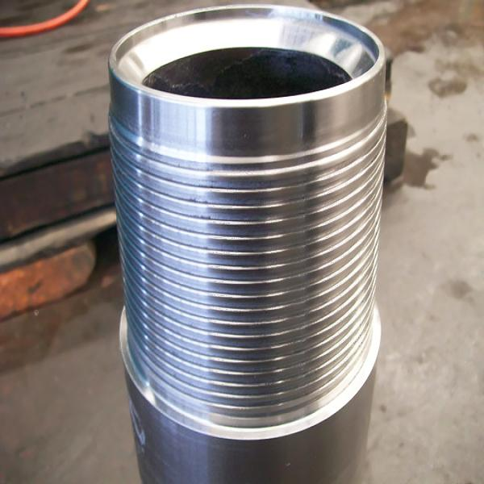
Products：Premium Connection
延迟符
China mills connections：
TP Series (TPCO)
BG Series (Bao steel)
HSM Series (VALIN steel)
WSP Series, etc.
©Partner (Tianjin) Oilfield Technology Services Co.,Ltd.

Slide 12
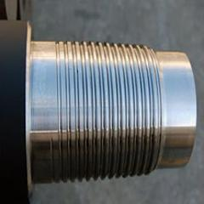
Products：Premium Connection
延迟符
Overseas Series：
Vam Series
Tenaris-Hydril Series
Hunting Series
JFE Series, etc.
©Partner (Tianjin) Oilfield Technology Services Co.,Ltd.

Slide 13
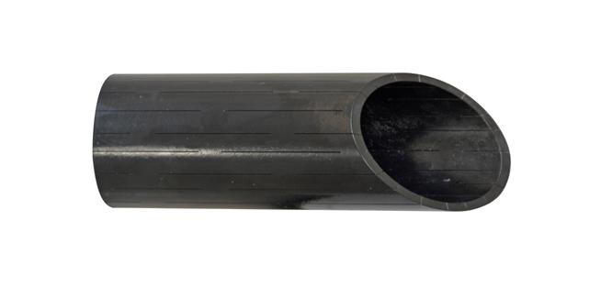
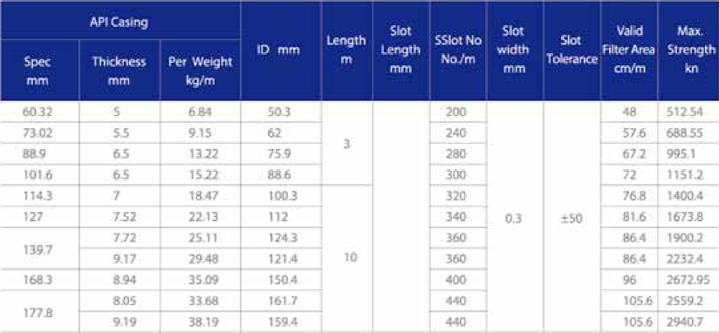
Product：Slotted casing/tubing
Applications
·sand control wells
·water projects
Type
.as per clients drawings
.design as per need
Machine type
.mechanical machine
.laser machine
Specifications
©Partner (Tianjin) Oilfield Technology Services Co.,Ltd.

Slide 14
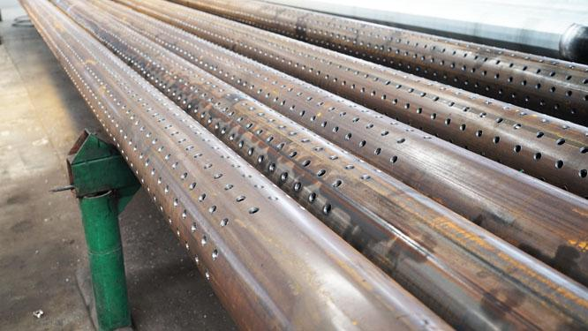
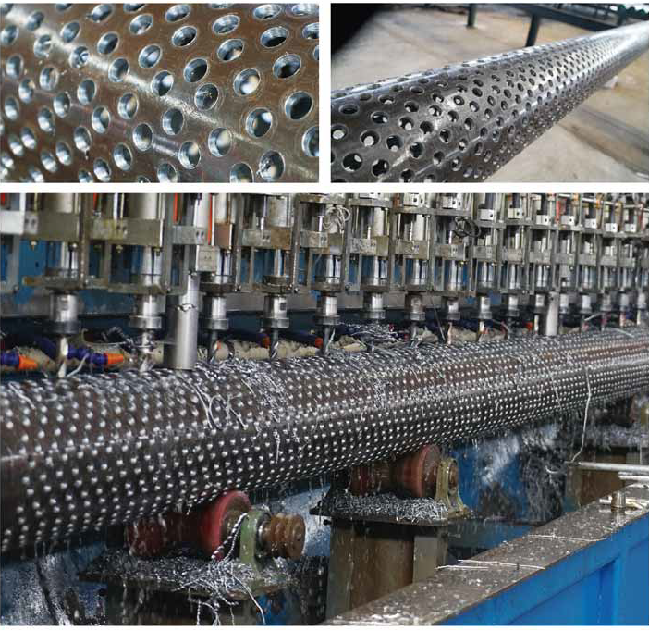
Products: Perforated pipe
Advantages：
·drill based on J55/N80 pipes
·tidy surface of drill hole
·anti-corrosion package
·drill type as per clients need.
©Partner (Tianjin) Oilfield Technology Services Co.,Ltd.

Slide 15
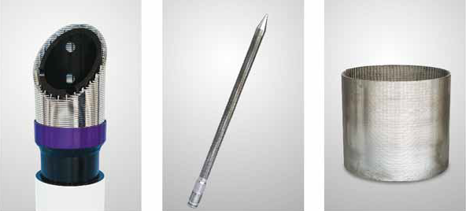
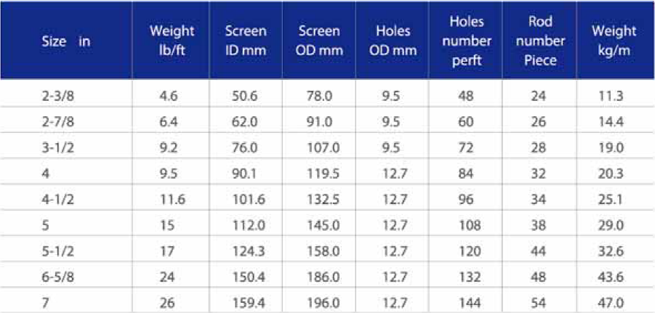
Products: wired screen pipe
·wire material：AISI 304， AISI304L， AISI 316， AISL316L
·base pipe：API J55,N80,P110,C90,13Cr, etc.
·open area can reach 60%
·slot range：0.1-2.0mm
·length(m)：1.8，3.0，6.0，9.0，12.0, etc
Specifications
©Partner (Tianjin) Oilfield Technology Services Co.,Ltd.

Slide 16
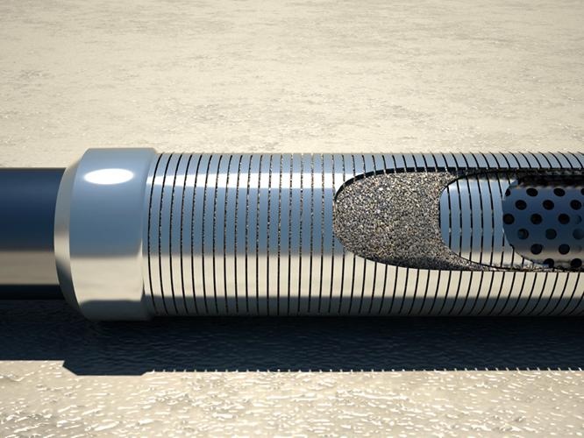
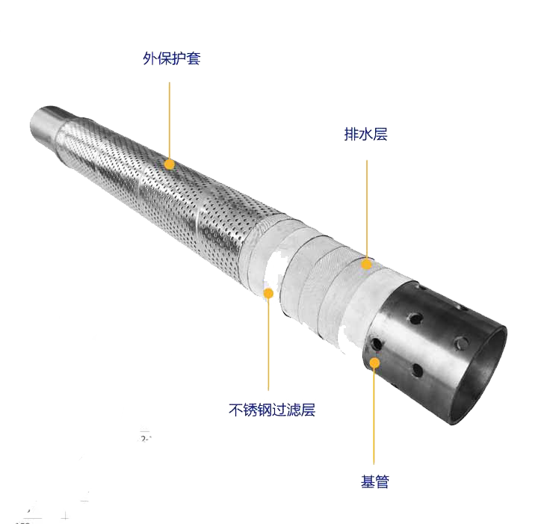
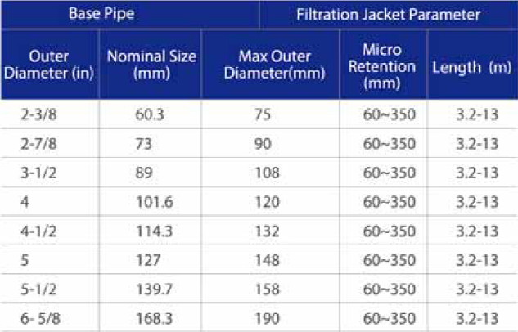
Product: Compound layers screen pipes
Descriptions:
Compound layers screen pipes have high performance filtering medias & high efficiency structures. Composited of base pipe, multi-layers filter screens &outside protection layer.
·Base pipe: oil pipe with 6-7% open area
·Grades：L80，13Cr，super13Cr
·connections：API & premium .
·materials：SS304，316L
·filter type：wired or sintering
·outside layer：20% open area
规格参数
©Partner (Tianjin) Oilfield Technology Services Co.,Ltd.

Slide 17
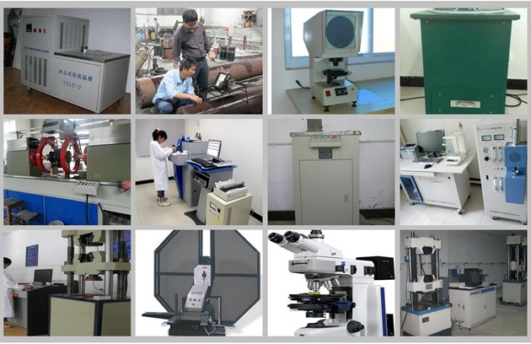
Inspections
©Partner (Tianjin) Oilfield Technology Services Co.,Ltd.

Slide 18
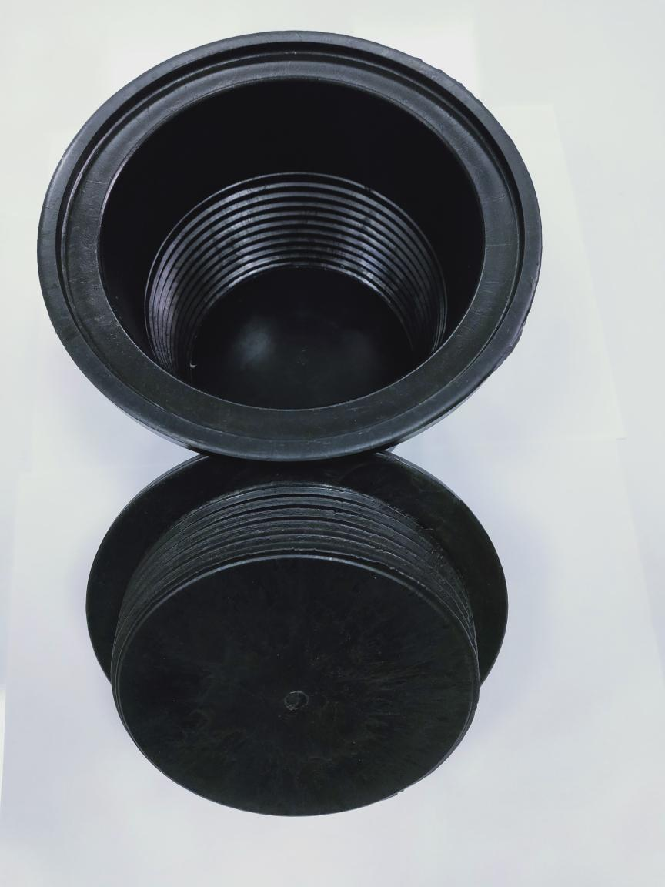
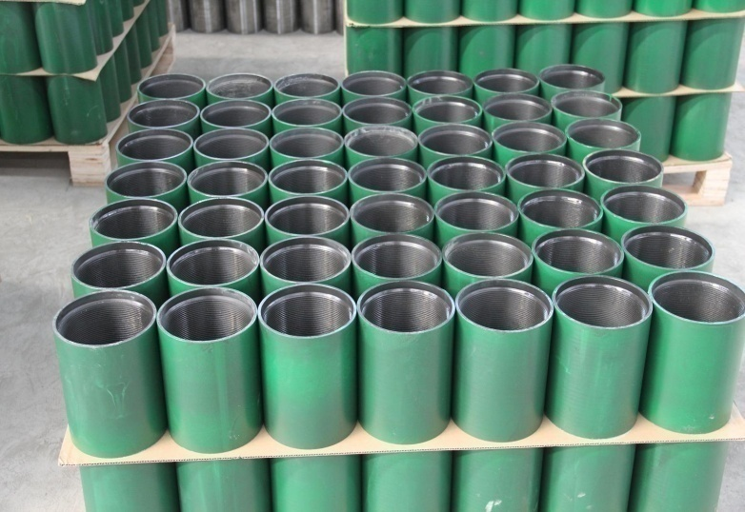
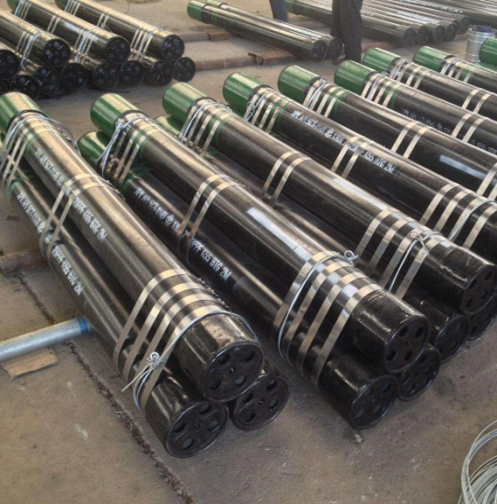
Others：OCTG accessories
Couplings
Thread Protectors
Pup Joints
©Partner (Tianjin) Oilfield Technology Services Co.,Ltd.

Slide 19
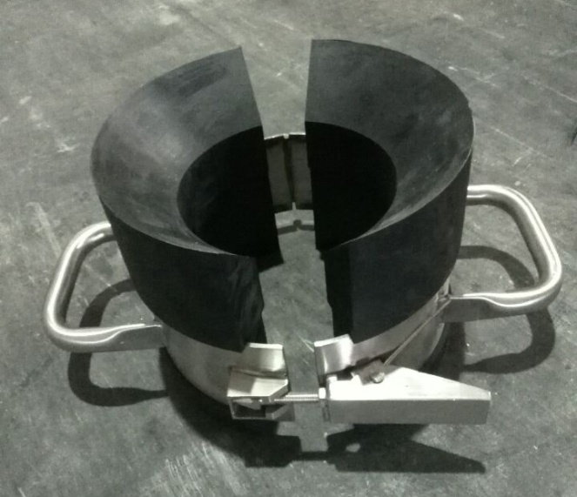
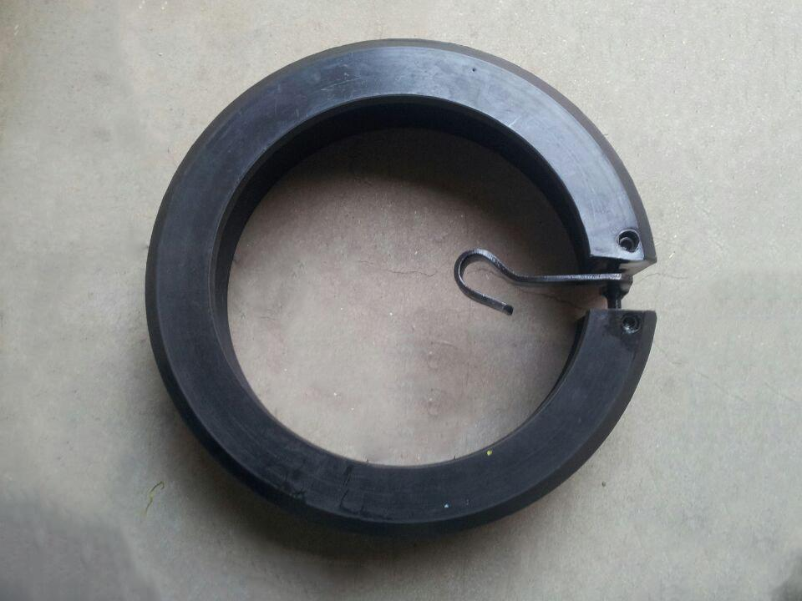
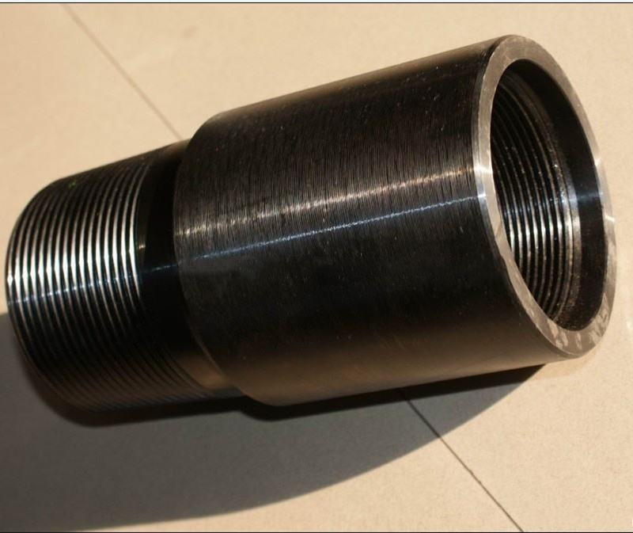
Others：OCTG accessories
Stabbing guide
Mechanical thread protector
X-Over
©Partner (Tianjin) Oilfield Technology Services Co.,Ltd.

Slide 20
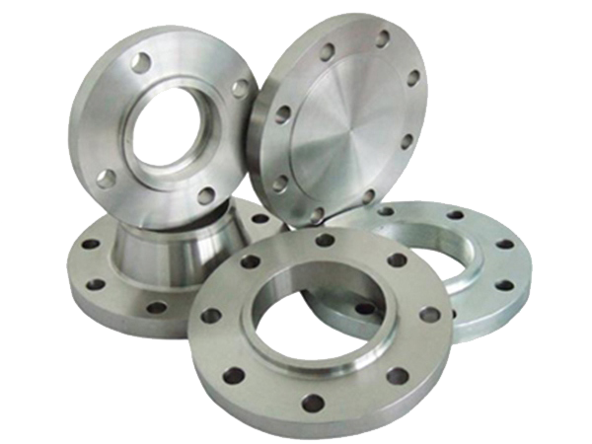
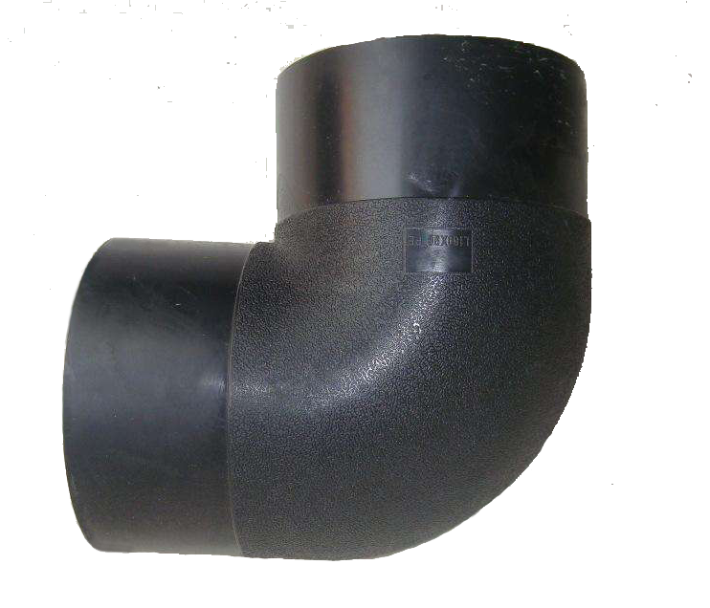
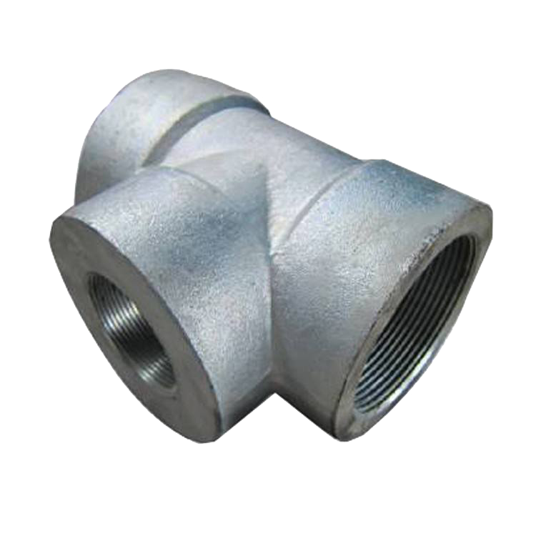
Others: Pipe fittings
Flange
Elbows
Tee
©Partner (Tianjin) Oilfield Technology Services Co.,Ltd.

Slide 21
Partner (Tianjin) Oilfield Technology Services Co., Ltd
Contacts: Mr. Brian Qiang Cell：15132768866 Email：qml@partnertj.com
Thank you!

